Slide 1

Exploratory data analysis
Michellé Greaves
2024/10/23

Slide 2


Agenda
Theoretical background of EDA
Sustainability
Practical example of EDA

Slide 3



Topic one
Exploratory Data Analysis

Slide 4
content
Introduction to Data Analysis
Introduction to EDA
Importance of EDA
Data Types
Data Visualization

Slide 5

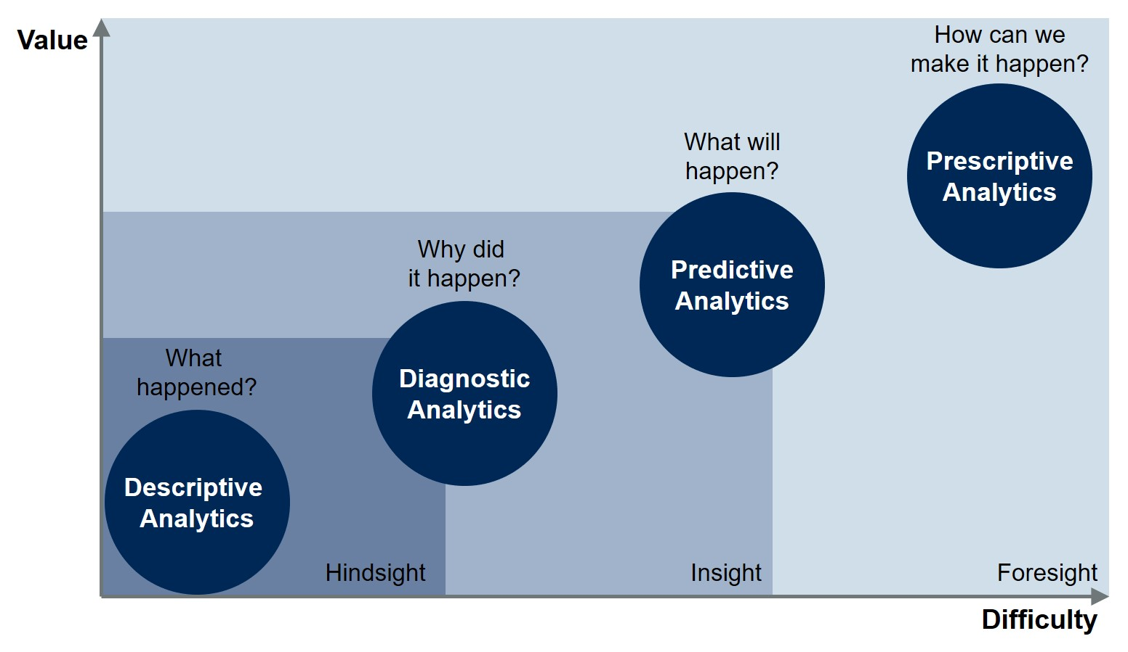

Introduction to data analysis

Slide 6
Introduction to eda
Exploratory data analysis is powerful, as it helps us to determine how best to manipulate data sources to get the answers needed, this mechanism helps to discover patterns, spot anomalies, test hypotheses and to validate assumptions.
EDA is the initial investigations on the data, it also helps to gain a better understanding of the data and gain insights from it.

Slide 7

Background of eda
EDA does not focus on the model that will be used but rather it focuses on discovering as much as possible from the data, gain an understanding of what is behind the data & it allows us to interpret the data and all its elements - then allowing the data to determine the model that would be best suited
Classical Method:
EDA:
Problem
Data
Model
Analysis
Conclusion
Problem
Data
Analysis
Model
Conclusion

Slide 8
Importance of eda
Identify most important variables/features in your dataset
Testing hypothesis related to the dataset
Data cleaning & checking the data quality
As an end result providing data/driven business insights to stakeholders
Analyze & summarize data sets
Feature engineering
Detecting outliers & dealing with them
Handling underfitting & overfitting

Slide 9
Three types of eda
Univariate Analysis – Analyzing a single variable
Bivariate Analysis – Analyzing two variables
Multivariate Analysis – Analyzing more than 2 variables

Slide 10
Three types of eda
Univariate Analysis – Height, salary, location
Bivariate Analysis – M/F population
Multivariate Analysis – Cancer based on a wide array of attributes

Slide 11
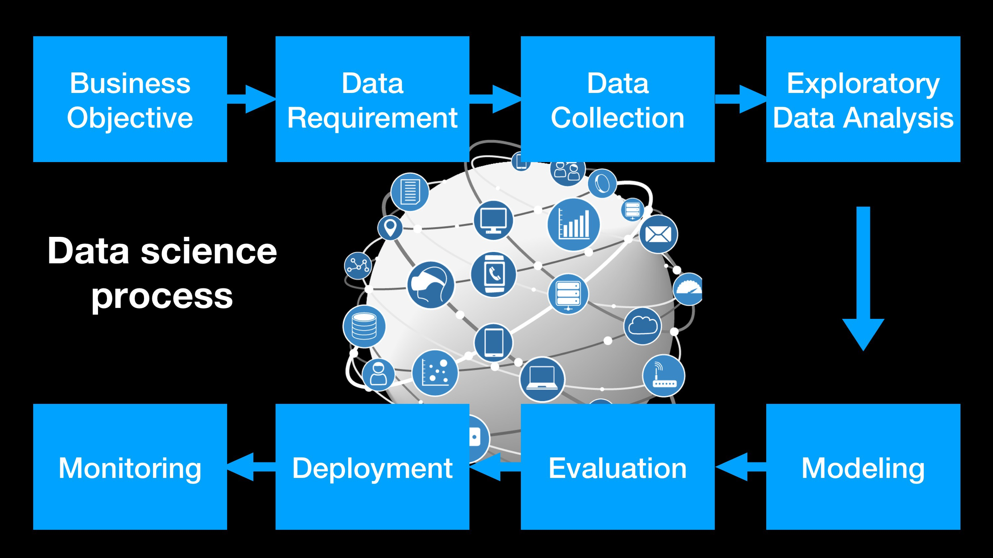
Data science process

Slide 12
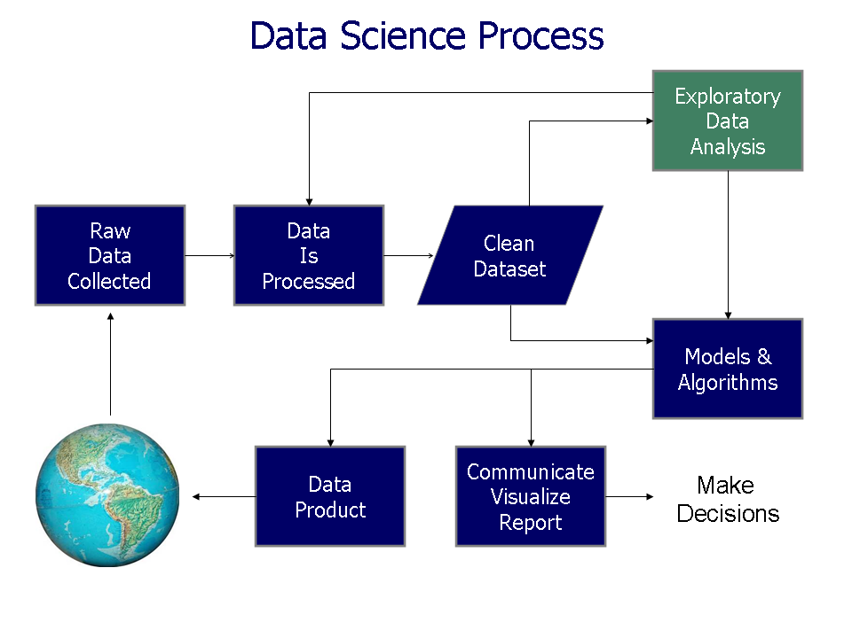
Deep dive into DSP

Slide 13
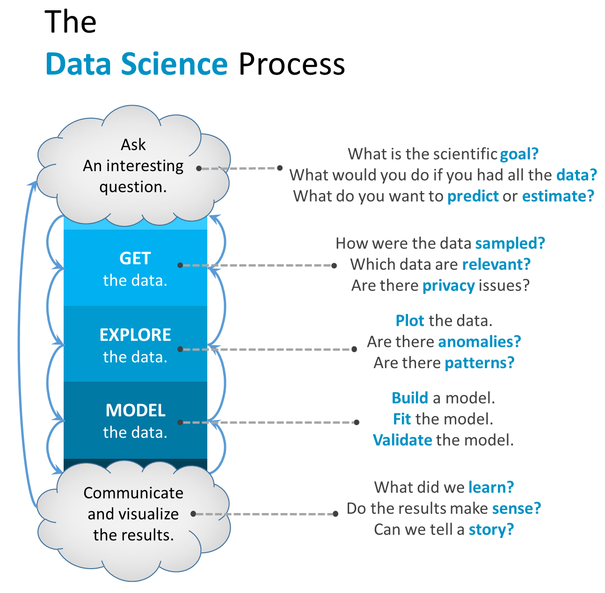
Asking the questions that you want to achieve in the EDA process.

Slide 14
Categories of data
Structured data types:
- csv files, excel files, database files etc
Unstructured data types:
- Images, video, audio etc.

Slide 15
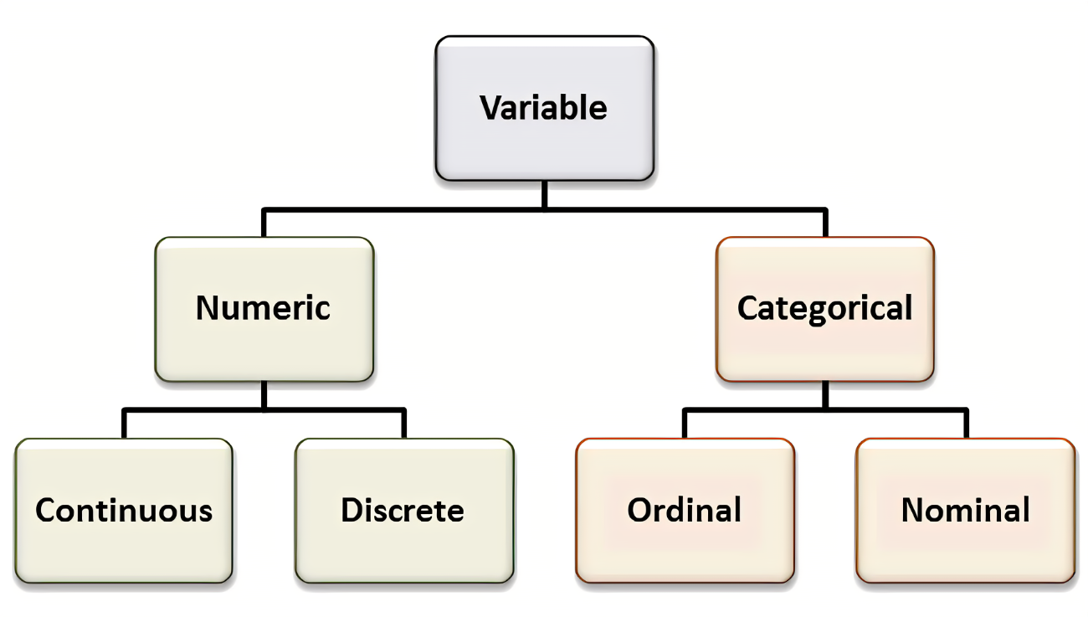
Data types

Slide 16
Important aspects to carry out of eda
Looking at the mean, median and mode
Outliers (through box plots for example)
Standard deviation
Skewness of the data

Slide 17
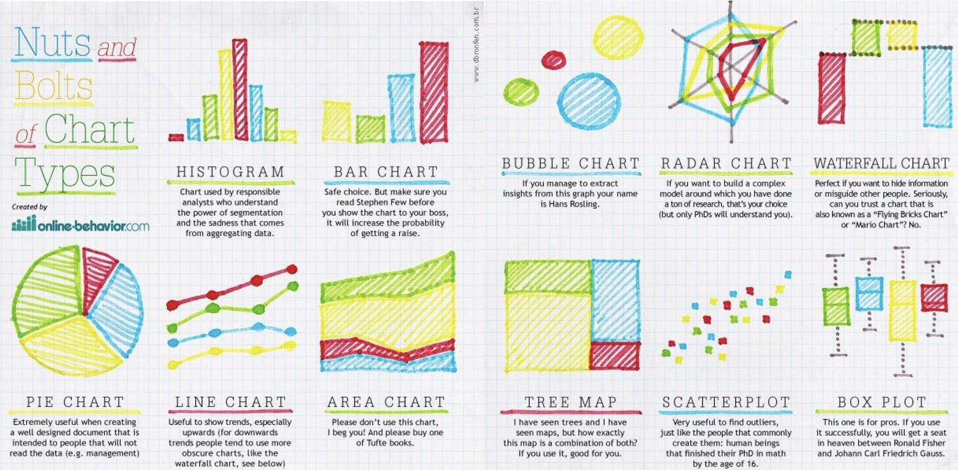
Data visualization

Slide 18
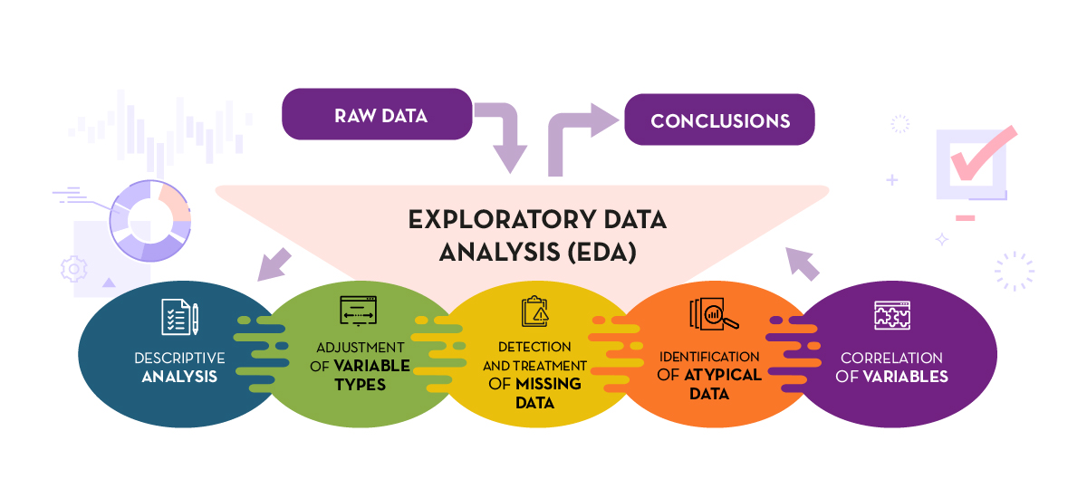
Sum-up eda

Slide 19
Topic two
Sustainability

Slide 20

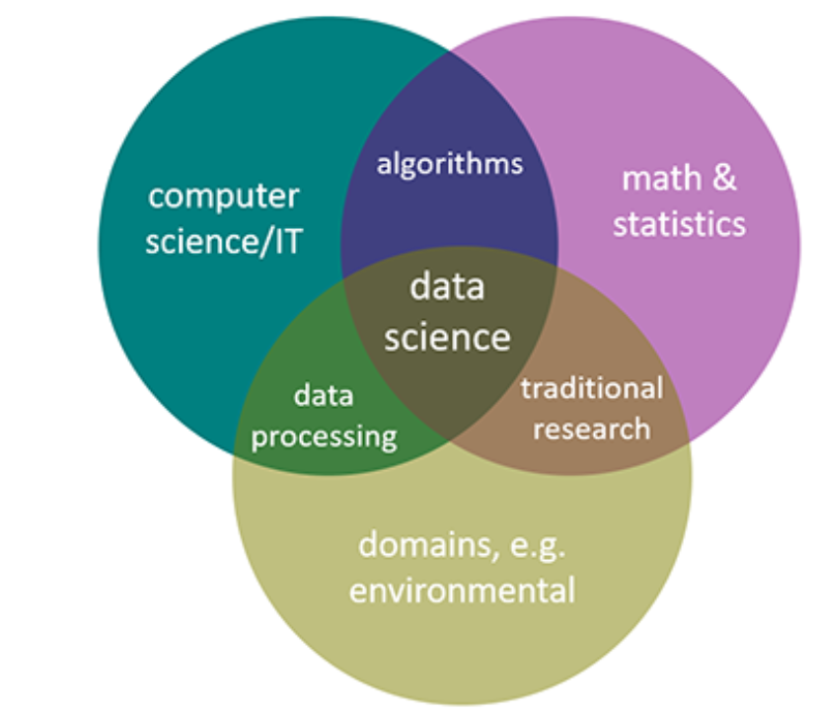
sustainability
Environmental
data science

Slide 21

Merge eda & sustainability

Slide 22
Topic three
EDA Practical

Slide 23
General steps to take in eda
Step 1:
Connect your data & get an overview
Start with the ETL
Understand what are you dealing with
Gain an initial understanding of your data
Step 2:
Work on data preparation
Identify duplicate values / columns
Deal with nulls & na’s
Rename columns where appropriate
Drop irrelevant rows or columns
Plot data to gain an understanding
Start with feature selection
Get your data into the format you want to work with
Step 3:
Feature understanding
Feature engineering & feature selection
Plot correlation graphs to understand which features would be best to use
Create new features where necessary
Step 4:
Hypothesis
Start asking what questions do you want to solve or dig deeper into
What problem are you trying to solve
How can the data answer your questions

Slide 24
python
Analyze data
- Data cleaning / data prep
Handle missing values
Duplicates
Detect patterns
Deep Dive into the data
Data Viz
Dealing with outliers (boxplot), plotting data in a histogram, scatter plot, etc.
- Correlation between different variables through a heatmap
Outcome
- Share with stakeholders the outcome & actions to move forward
Modelling
- To apply a desired model to the data

Slide 25
Commands in Python
Run commands:
df.info(),
df.head(),
df.tail(),
df.describe(),
df.dtypes,
df.shape(),
df.isnull().sum(),
df.isna ().sum(),
df.value_counts(),
df.columns(),
df.isna().any(),
df[‘column name‘].count,
df[‘column name’].unique(),
df[‘column name'].value_counts().idxmax(),
df[‘column name'].value_counts().idxmin(),
data.iloc[data[‘column name’].idxmax()],
data.iloc[data[‘column name’].idxmin()],
df.drop()

Slide 26
Commands in Python
Run commands:
df.[column name].value_counts()
.head()
.plot( kind = ‘bar’)
Plot: df1 = df.column_name.value_counts()
sns.barplot( y = df1.index, x = data1)
df.[‘column name’].plot(kind =‘hist’)

Slide 27
python
Descriptive analytics is a helpful way to deep dive into the characteristics of the data & to get a quick summary of what is in it. This can be done through df.describe(). You will get the basic statistical analysis such as count, mean, min, max etc.

Slide 28
Topic four
The role of data in Design Making

Slide 29
Basic Principles of decision making
From EDA you need to provide valuable insights that will inform decisions
EDA helps you to prepare for the outcome of the Datathon by focusing on analytics techniques, such as predictive modelling and scenario analysis, this allows your audience to understand the impact for example, to be able to forecast future performance and understand the potential impact of different opportunities.
EDA allows you to uncover opportunities and risks that may not have been immediately apparent
Ability to enhance negotiation strategies

Slide 30
TIMELINE
Datathon Kickoff
15th October
.
Workshop EDA
23rd October 2024
Mentorship - start to end
3 mentorship Sessions to assist during the mentorship
Workshop Storytelling
End of Datathon - 11th December 2025
Submission of end result

Slide 31

The way to get started is to quit talking and begin doing.
Walt Disney

Slide 32




Summary
Discover hidden patterns in the data, user a model that will answer your questions – what is the end point & goal you want to reach.
Refer to:
Kaggle
https://www.kaggle.com/code/ekami66/detailed-exploratory-data-analysis-with-python/notebook
https://www.kaggle.com/code/imoore/intro-to-exploratory-data-analysis-eda-in-python
https://www.kaggle.com/code/agrawaladitya/step-by-step-data-preprocessing-eda
Medium
Future readings for what is to come in data prep:
https://aws.amazon.com/blogs/machine-learning/prepare-data-from-snowflake-for-machine-learning-with-amazon-sagemaker-data-wrangler/

Slide 33

Thank you
Michellé Greaves
Michelle.merrie.greaves@gmail.com

